Slide 1
Using the Social Network for B2B Marketing Success
Srinivas B Vijayaraghavan,
Director Marketing, Tejas Networks

Slide 2
The changing paradigm
‘Jab mein pachchees ka tha, baatein Facebook pe nahin, face to face hua karti thi’
-Daddu, Kotak Mahindra Silver Jubilee Ad

Slide 3
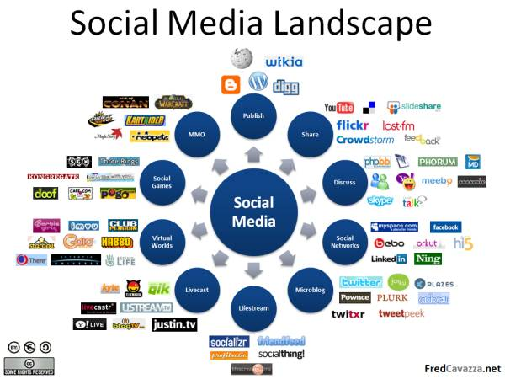
Things that you already know
Social Media is here
It is here to stay
Social Media Marketing is the new Buzz
It is here to stay as well
Lets wear our marketing hats and ask ourselves-what does this do for us?
Do we know?

Slide 4
Lets try some customer situations. Is social media marketing relevant?
Low Value
Wants to buy a pencil
Wants to buy a movie ticket
Wants to buy a cell phone
Wants to buy a computer
Wants to buy clothes
Wants to buy a HDTV/Home Theatre/Fridge
Wants to buy a car
Wants to buy a house/plot
B2C
High
Value

Slide 5
Lets change the customer situations. Is social media marketing relevant?
Wants to buy an IT server
Wants to outsource office housekeeping
Wants to buy power plant equipment
Wants to implement Core Banking
B2B
Wants to build a flyover
Wants to automate a manufacturing plant
Wants to start a retail chain
Wants to roll out a 3G network

Slide 6
How are B2B marketers reacting to social media?
86% are ‘using’ social media
59% have ‘basic presence/not active’
50% face ‘perceived irrelevance’
50% ‘prefer traditional methods’
36% have a ‘low executive interest’
30% fear ‘loss of brand control’
-White Horse Survey (104 B2B marketers)

Slide 7
Is there hope?
How are customers doing? (1200 US, European B2B buyers)
91% of B2B decision read/watch content (Spectators)
69% of these read business-relevant content
55% were members of social networking websites (Joiners)
43% wrote blogs, uploaded content (creators)
58% react to content (critics)
B2B Social Media Spending will increase to $54 million in 2014 as compared to $11 million in 2009
-Forrester Research
The question is not ‘should’ but ‘how should’ B2B Marketers use Social Media Marketing effectively

Slide 8
How to use social media as a B2B marketer
Ready your content
Set your goals
Choose the right platforms
Customer &
Competitor
Be regular and engage
Use the right tools
Use force multipliers
Define Metrics

Slide 9
#1 Customer & Competitor
Classify customers based on their social medianess
Creators: Write blogs, upload stuff
Critics: Respond to content, post comments
Collectors: Organize content for themselves
Joiners: Connect in personal social networks
Spectators: Read blogs, videos, reviews
Inactives: None of the above
How? Customer Survey (online/face-2-face)
Rate your competition on the type of social media marketing they use.
Know Thy Customer is not a cliché. Don’t do anything without it!

Slide 10
#2 Set your Goals: Social Media Marketing Sweet Spot
Awareness
Interest
Desire
Action
Satisfaction
Cognition
Affect
Behavior

Slide 11
#3#4 Content and Platforms
Website/
Blogs
Videos & Presns.
Company Portal
Product /Solution Simulations
Personal Networking Sites
Microblogs
Product Launch/Announcement

Slide 12
#5#6 Regular Engage Multiply
If you have a blog, blog
If you have a twitter account, tweet
Find excuses to put something out there!
Encourage people to comment, retweet, share on facebook, digg, del.icio.us
Get people to subscribe to your blog via RSS

Slide 13
#7#8 Define Metrics & Tools
Followers, Page Views/Impressions
Time spent, Comments/Likes
Downloads, Sharing, Retweets
Tools available
Unilyzer
Facebook Insights
TweetStats
YouTube Insight
Google Alerts, Analytics
PostRank Analytics

Slide 14
B2B Social Media Marketing Red Lights
Relying only on social media
Lack of constant engagement
Don’t give it enough time
Using it as a direct response vehicle
Expecting instant results
Content focusing on self
Not building networks using syndication
Not Interlinking content

Slide 15
Examples of good social media sites
HP product blogs, videos & facebook page
IBM DeveloperWorks, AlphaWorks
IBM Research facebook page

